Slide 1




DEFENSE
MECHANISMS
Miss Ayesha Bano
aisha.bano@nu.edu.pk

Slide 2

ID
Defense mechanisms are invented by the Ego to resolve the conflict between ID and Superego. so that personality can operate in a healthy manner .
Ego
Super ego

Slide 3
PROPERTIES
All defense mechanisms have 2 properties
Deny or distort reality in some way
Operate in unconscious level to protest anxiety

Slide 4
To safeguard the mind against feelings and thoughts that are too difficult for the conscious mind to cope with.

Slide 5


1: DENIAL
REALITY
Reality is distorted to make it suit to the individual’s wishes.
When you use denial, you simply refuse to accept the truth or reality of a fact or experience.

Slide 6


EXAMPLES
Heavy smokers' individuals may refuse to admit that smoking is bad for their health Operate in unconscious level to protest anxiety
An alcoholic fails to acknowledge that he is addicted to alcohol

Slide 7
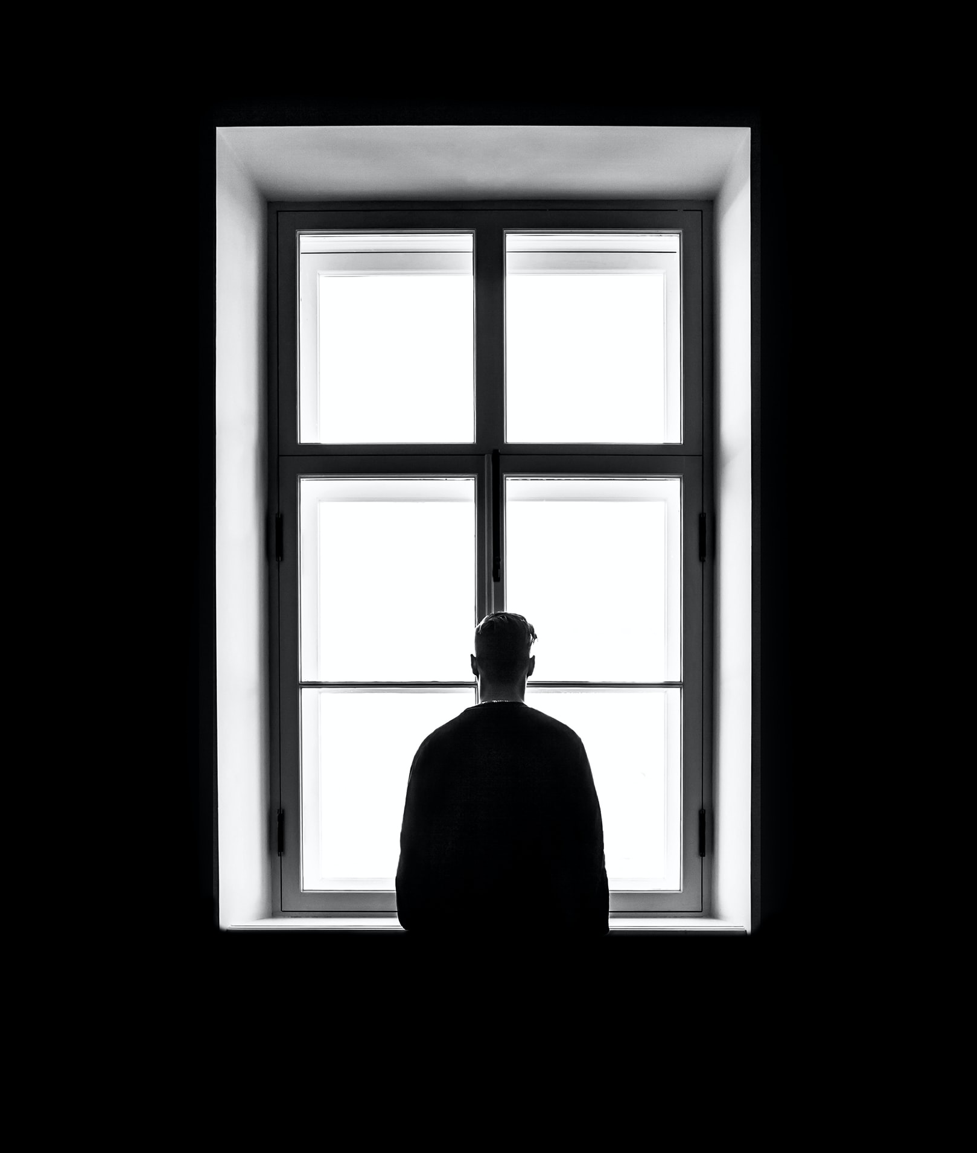
2: REPRESSION
Unpleasant experiences are subdued in the unconscious mind and can’t be access by the conscious mind.
Thoughts that are often repressed are those that would result in feelings of guilt from the superego.

Slide 8

EXAMPLES
.
An accident victim nearly dies but remembers none of the details of the accident.
.
A person who has repressed memories of abuse suffered as child may later.

Slide 9

3: RATIONALIZATION
To protect our sense of self-esteem.
Providing a reasonable explanation to make unreasonable behavior appear logical and justify their action.

Slide 10


Slide 11

4: SUBLIMATION
Productive defense mechanism.
It transforms unacceptable impulse into socially accepted behavior.

Slide 12

EXAMPLES
.
A person experiencing extreme anger might take up kickboxing as a means of venting frustration.
.
Many great artists have had unhappy lives and have used the medium of art of music to express themselves.

Slide 13
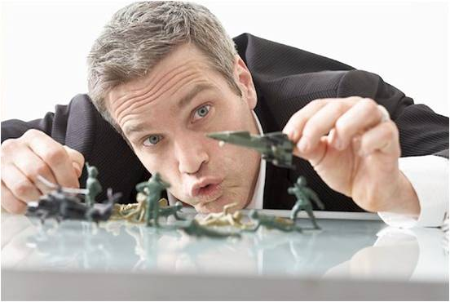
5: REGRESSION
Returning to a behavior pattern characteristic of an earlier stage of development.
People act out behaviors from the stage of psychosexual development in which they are fixated.

Slide 14

6: Reaction Formation
Thinking or behaving in a way that is the extreme opposite to those that are of real intention
Reaction formation means expressing the opposite of your feelings in your outward behavior

Slide 15
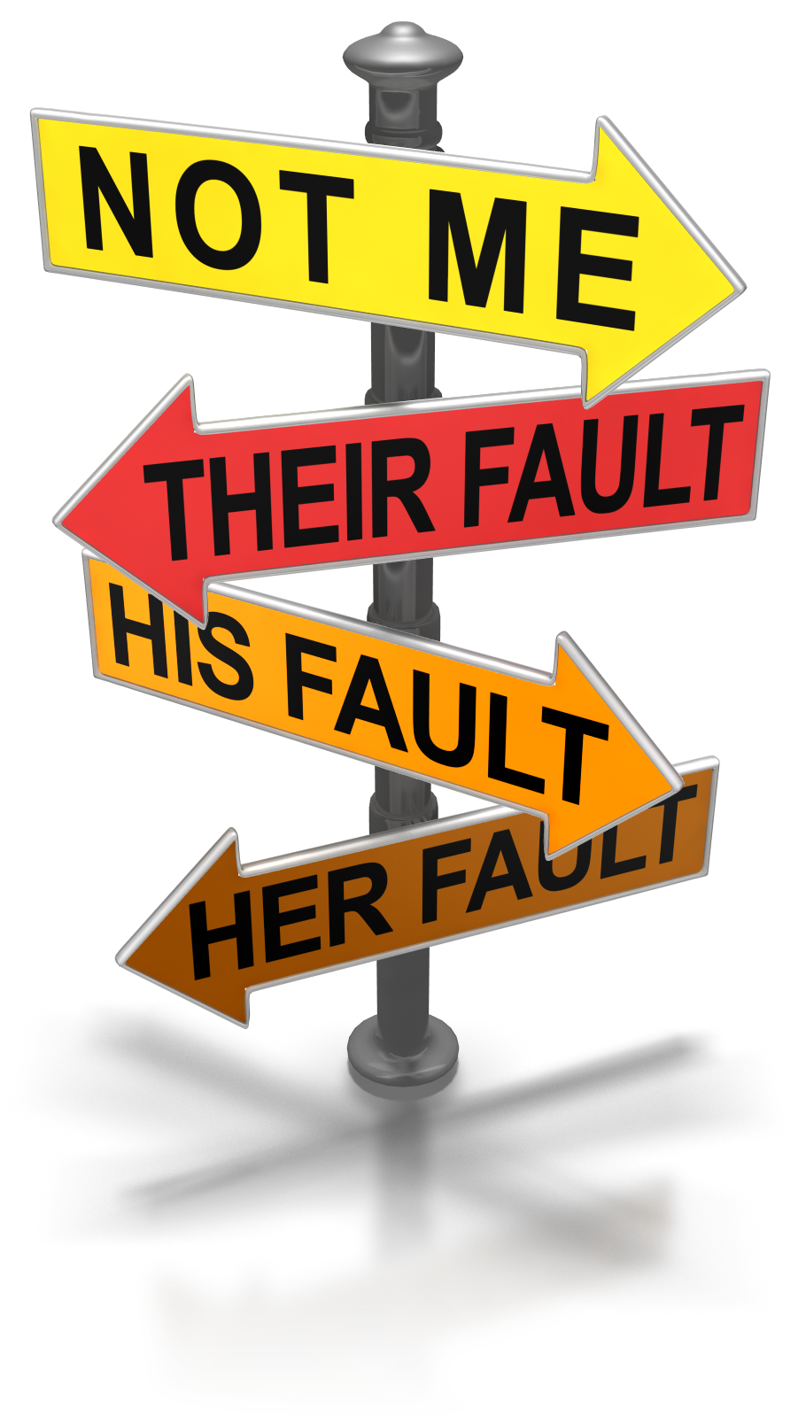
7: PROJECTION
This involves individuals attributing their own unacceptable thoughts, feeling and motives to another person .
You might hate someone, but your superego tells you that such hatred is unacceptable. You can 'solve' the problem by believing that they hate you.

Slide 16

8: INTELLECTUALIZATION
You think away an emotion or reaction that you don't enjoy feeling. Although you aren't denying that the event occurred, you're not thinking about its emotional consequences but instead focus only on the intellectual component.
Example :
Greg learns that he has cancer. He begins to learn everything he can about the illness, reading books, journal articles, and the latest experimental research

Slide 17
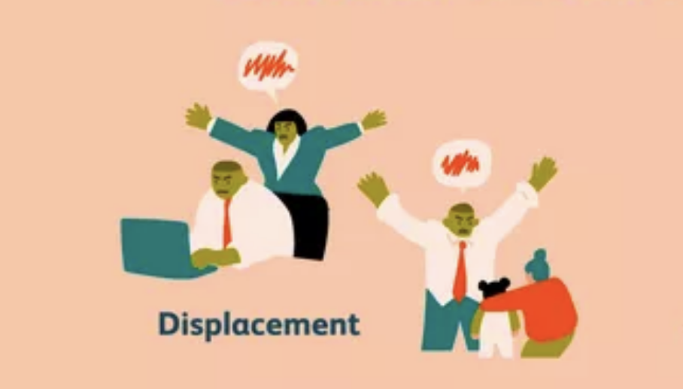
9: DISPLACEMENT
Redirecting the feelings of hostility and violent action from self to someone that is less threatening instead of expressing to the real.
Example:
Angered by a boss hateful comment, a dad punishes his family for accidentally spilling her drinks. The dad redirects the anger of boss towards his child.

Slide 18
Thank you

